Slide 1
Interview clinic

Slide 2
Program objectives
At the end of this 2 hours session, you will be able to
Find relevant information about a client
Create an impactful introduction
Identify the style of an interviewer
Apply the STAR method for interview questions.

Slide 3
Part-1
Preparation
Notes:
WIIFM
Self-boost confidence for the interview
Academy- You get a job
Family- Less worried

Slide 4
Know your client

Slide 5
Things to consider
What do you generally find out about a client before an interview?
How do you use the information gathered for preparing for the interview?

Slide 6
Typical questions for researching a client
What is their primary service or product?
Who is their client or customer?
What technologies are likely to be used in the project?
Which geos do they use?
Clients look at things from their perspective not yours
Notes:
Many of these will be applicable if they are going for valiant interviews. Do let them know that it shall soon happen in a few months after joining –
Adding few more question that might be useful. Ask them to list down their domain and any information they may have of the domain or client they are allocated to( if they are allocated already)
What is their primary service or product?
What is their business goal?
Who is their client or customer?
Who are their competitors?
What projects has Cognizant carried out for them?
What is current project about?
What technologies are likely to be used in the project?
How does your role contribute to the project success?
What professional capabilities do they value?
What are project practices of the client?
Whaqt are their cultural/work values?
What is the mission and vision of the company?

Slide 7
Knowing the client helps you orient your expertise to their requirements
Mention relevant accomplishments in your CV
Substantiate with relevant examples
Ask questions that reflect your understanding of their business
Remember
Client do not ask general questions about ourselves
However, they expect you to know their context
Gather information about clients from legitimate sources

Slide 8
List down the attributes a project looks for in a new hire
Notes:
Ask them to list down the attributes in a group-5 min activity

Slide 9
Aligning your resume to the client/ project and job

Slide 10
How to prepare an Effective Resume?
Outline your skills , abilities, work experience and extracurricular activities on paper.
Add your contact information , and contact numbers, link to work Social profiles
Tailor your objectives to each company you target or every job role you seek.
List your Academy experience , projects, internship details . If you are a new hire
Notes:
Outline your skills , abilities, work experience and extracurricular activities on paper.
Add your contact information , and contact numbers, link to work Social profiles.

Slide 11
Check your resume
Why is it important to relook at your resume every time?
Look at
How you have presented your expertise
The content
The phrasing
The format

Slide 12
Four things that your resume must sum up
What did you do in your earlier projects in campus
What was your contribution?
What challenges did you face?
How did you overcome these challenges ? What learning did you take away?
Do not under sell or over sell yourself
Notes:
For new hires
They can highlight their learning and accomplishments at Academy.
You delivered on-time and on budget
Defined a problem, developed and delivered the solution.
Managed through difficulties and deadline and deliver a quality result
Worked with different teams as well as an individual contributor
You carried out multiple responsibilities
Do not give any indication of self-doubt
Present information that you can defend

Slide 13
Part-II –Itroductions

Slide 14
Discuss
What do you generally say when introducing yourself?
Should you say something more?
If you wer the client, what would you expect in an introduction?
Your introduction is the first positive note that you strike with client.
Notes:
Your generic introduction VS an introduction for interview will vary .You need to sell yourself, be a brand

Slide 15
Script your introduction- Give a snapshot of yourself
Use about 80 tp 100 words to speak for about 60 seconds Use crisp , short sentences Avoid self-doubting phrases such as ‘ I think I am good at”
State your name
Say a bit about your background , you’re learning at academy
Say about your previous projects at campus and what role you played and the learning from it
State what key attributes you possess and how that will benefit them
Say what your skills are and what you look forward to doing in your career
Notes:
State your name
Say a bit about your background , you’re learning at academy
Say about your previous projects at campus and what role you played and the learning from it
State what key attributes you possess and how that will benefit them
Say what your skills are and what you look forward to doing in your career

Slide 16
Tip: Use verbs that sound dynamic
Created | Achieved | Forecasted
Launched | Improvised | Challenged

Slide 17
Tip : keep your sentences short and to the point
Use active not passive sentences | Be straight forward
Say “ I analyzed and developed the project” | Say I rewrote the project
Not “The project was analyzed and developed by me” | I was responsible for improving the quality of…”

Slide 18
Prepare your introduction
1.Name
2. Background if experience any
3. Your current track and learnings from Academy
4. Your experience, projects, certifications etc,.,
5. What are your key skills are and what you look forward to doing in your career
Notes:
Work in pairs, do ask them to record their introduction on phone after the session
Name and Education: Start by stating your name clearly and mention your current educational background, including your degree or any relevant courses you've pursued.
Career Objective or Summary: Provide a brief overview of your career objective or a summary of your skills and aspirations. This helps the interviewer understand your goals and what you're looking to achieve.
Key Strengths and Skills: Highlight your key strengths and skills that are relevant to the job you're applying for. These could include technical skills, soft skills, or any other competencies that make you suitable for the role.
Relevant Experiences (if any): If you have any relevant internship experiences, projects, or extracurricular activities, briefly mention them to demonstrate your practical knowledge and abilities.
Passion and Enthusiasm: Express your passion and enthusiasm for the field or industry you're entering. Show your eagerness to learn and contribute to the organization.
Personal Traits: Mention a few positive personal traits that describe you as a person, such as being a team player, a quick learner, or having strong problem-solving abilities.
Interest in the Company: Demonstrate your interest in the company by mentioning why you're excited about the opportunity to work there. This could include aspects such as the company's values, products, or recent achievements.
Closing Statement: Conclude your introduction with a strong closing statement, expressing your gratitude for the opportunity to interview and your readiness to answer any further questions they may have.
Remember to keep your introduction concise and focused, aiming to provide a clear overview of who you are and why you're a suitable candidate for the position. Practice your introduction beforehand to ensure you deliver it confidently during the interview.

Slide 19
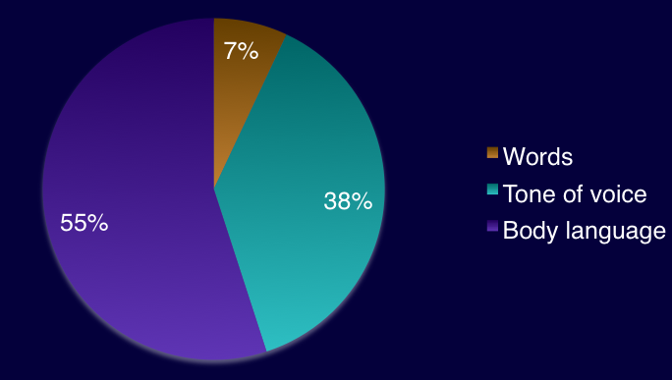
Impactful body language

Slide 20
Practice your introduction
Ask the Participants to pair up and practice powerful introduction keeping in mind the right body language etc. They can connect through video calls on their smart phone for this activity
Give them 15 min to finish for this activity
Notes:
Ask the associates to pair up and practice powerful introduction keeping in mind the right body langusge etc. they can connect through video calls on their smart phone for this activity
Give them 15 min to finish for this activity

Slide 21
PART-III Ace your interview

Slide 22
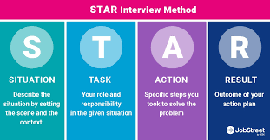
STAR technique
Notes:
What is the STAR method?
The STAR method is an interview technique that gives you a straightforward format you can use to tell a story by laying out the situation, task, action, and result.
Situation: Set the scene and give the necessary details of your example.
Task: Describe what your responsibility was in that situation.
Action: Explain exactly what steps you took to address it.
Result: Share what outcomes your actions achieved.

Slide 23
Activity :-Using the STAR method Tell me about a time you….
Defined a problem , developed and delivered the solution | Managed through difficulties to meet the deadline and deliver a quality result
Notes:
Ask the participants to work in pairs and practice

Slide 24
Part IV- Handling Questions

Slide 25
What would you say?
When you know something similar
When you have some exposure
When you just don’t know
Notes:
Activity

Slide 26
Thank you

